Slide 1
Advanced OOP(1)
Do Quoc Binh

Slide 2
The concepts of object-oriented Encapsulation
Review
Encapsulation is the combination of the data and actions that are related to an object.
When encapsulating, you often want to control what can access those actions and the data, for example, restricting how the internal state of an object can be accessed or modified from the outside.

Slide 3
The concepts of object-oriented Composition
Review
Composition is about what an object is made of. For example, a car is composed of different parts, such as four wheels, several seats, and an engine.

Slide 4
The concepts of object-oriented Aggregation
Review
Aggregation is about what can be combined with an object. For example, a person is not part of a car object, but they could sit in the driver's seat and then becomes the car's driver. Two separate objects that are aggregated together to form a new component

Slide 5
The concepts of object-oriented Inheritance
Review
Inheritance is about reusing code by having a subclass derive from a base or super class. All functionality in the base class is inherited by and becomes available in the derived class

Slide 6
The concepts of object-oriented Abstraction
Review
Abstraction is about capturing the core idea of an object and ignoring the details or specifics. C# has an abstract keyword which formalizes the concept.
For example, the super class Stream is abstract and its sub classes like FileStream and MemoryStream are concrete.

Slide 7
The concepts of object-oriented Polymorphism
Review
Polymorphism is about allowing a derived class to override an inherited action to provide custom behavior

Slide 8
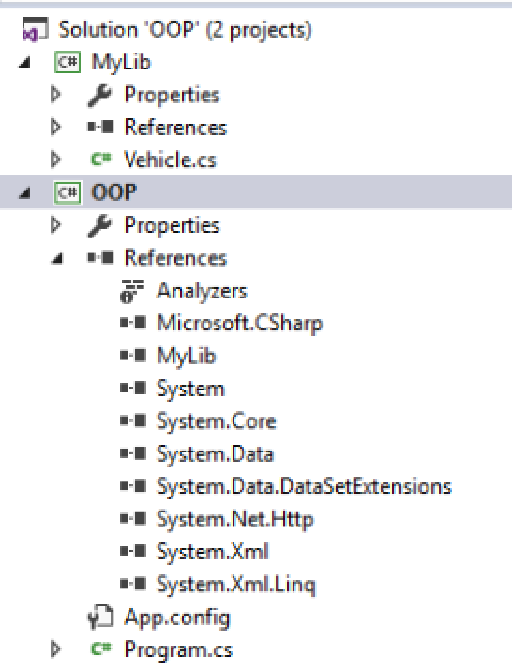
Building class libraries(make reusable code)
Class library assemblies group types together into easily deployable units (DLL files).
MyLib is a user Library and used by OOP

Slide 9
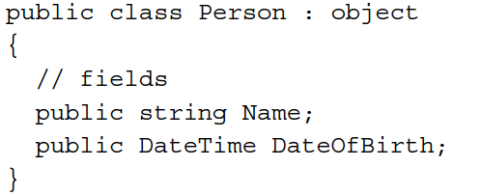
Defining fields
Let's say that we have decided that a person is composed of a name and a date of birth. We will encapsulate these two values inside a person, and the values will be visible outside it.
Public is an access modifier in C#

Slide 10
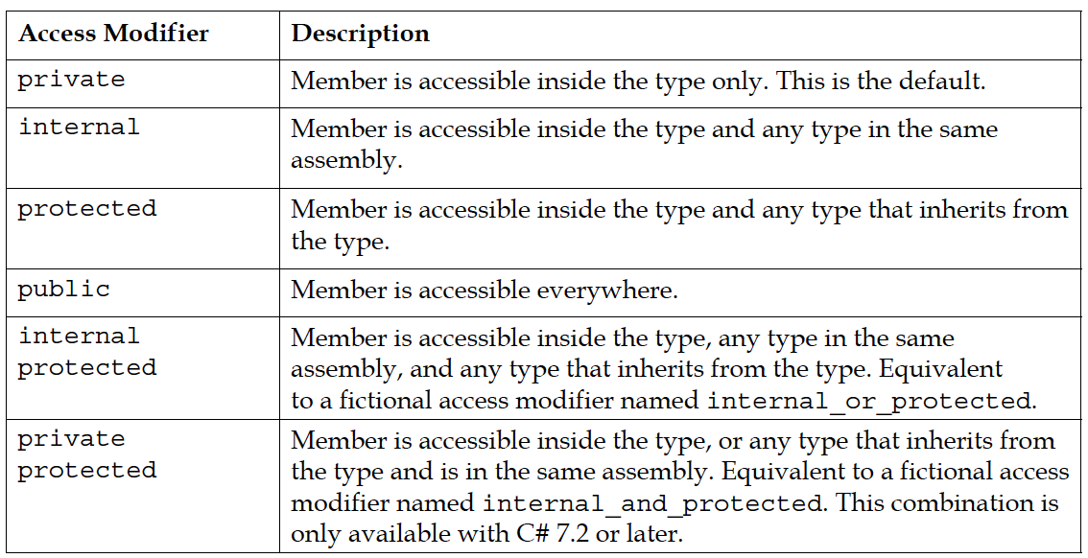
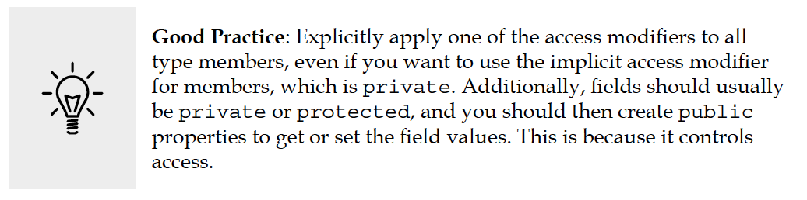
Understanding access modifiers

Slide 11
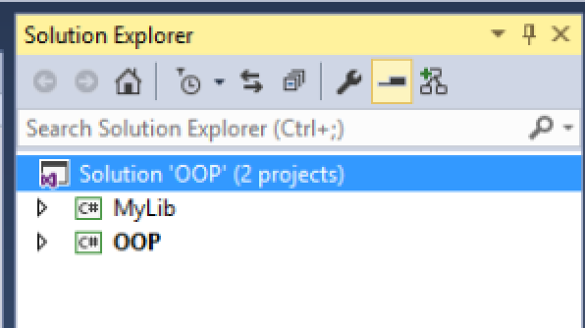
Assembly
In the following example we have 2 assemblies in one solution. One is a class library and the other is an excutable(.exe) project

Slide 12
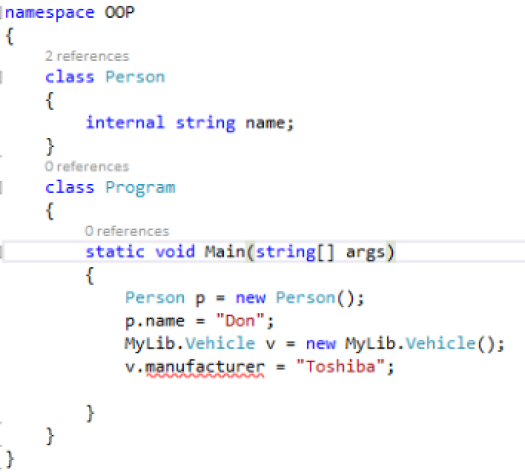
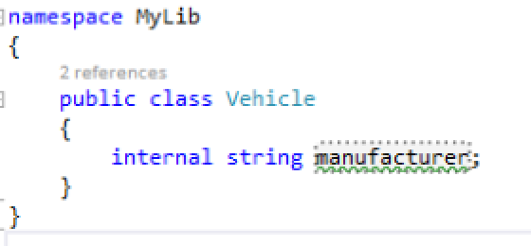
Example use of internal modifier
Program and Person are in the same Assembly while Program and Vehicle are in different library. That is why the VS alerts an error.

Slide 13
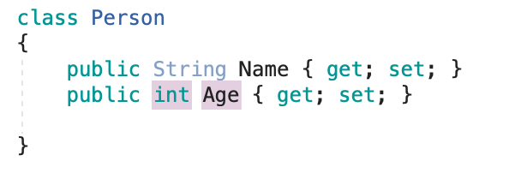
Declaring properties
The following properties can both read and write

Slide 14
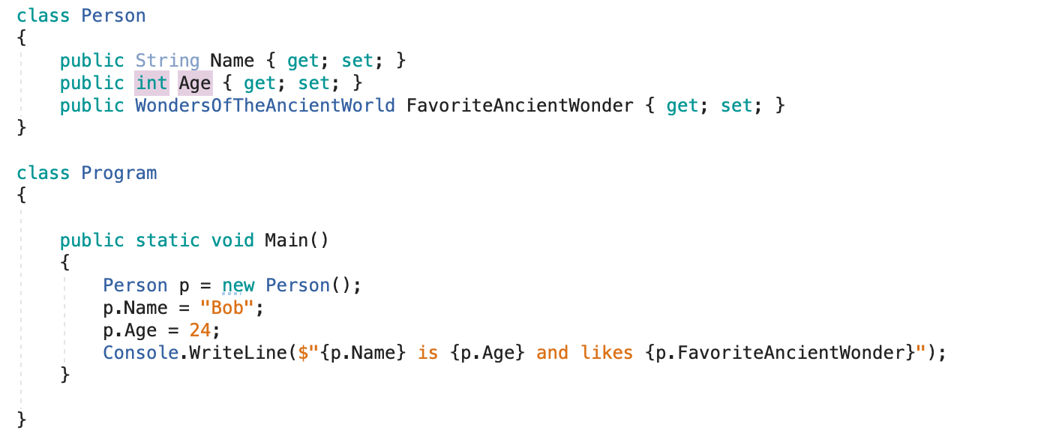
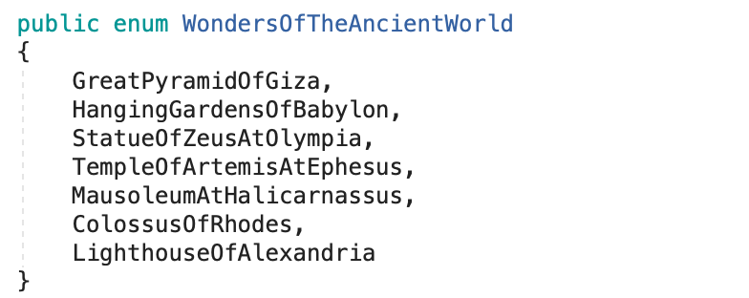
Properties with example

Slide 15
More way of initializing object

Slide 16
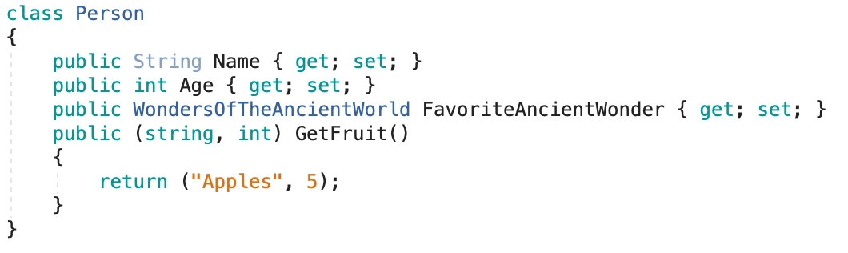

Combining multiple returned values using tuples
Tuples have been added support for them in .NET 4.0 with the System.Tuple type
In Main:

Slide 17
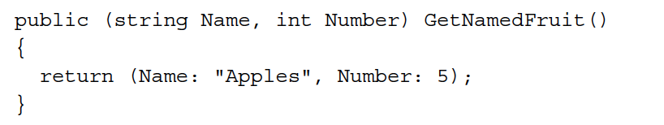
Naming the fields of a tuple

Slide 18
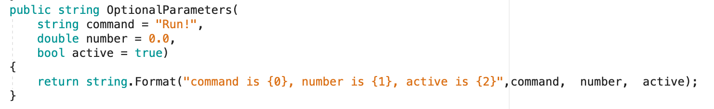
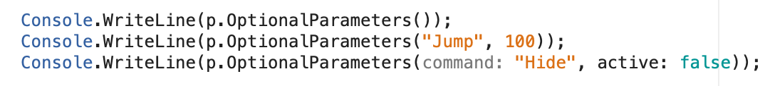
Passing optional parameters and naming arguments
Possible uses

Slide 19
Pass parameters by value and reference
When a parameter is passed into a method, it can be passed in one of three ways:
By value (this is the default): Think of these as being in-only.
By reference as a ref parameter: Think of these as being in-and-out.
As an out parameter: Think of these as being out-only.

Slide 20
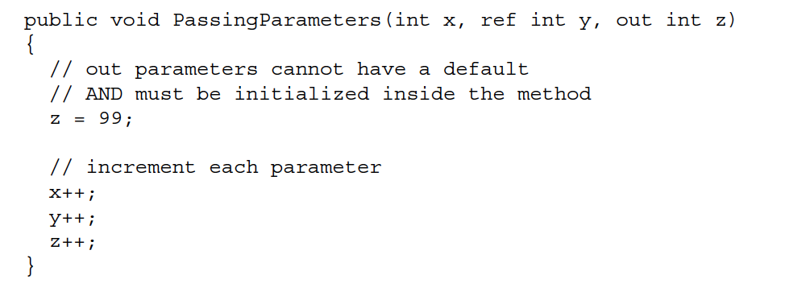
Example of passing parameters

Slide 21
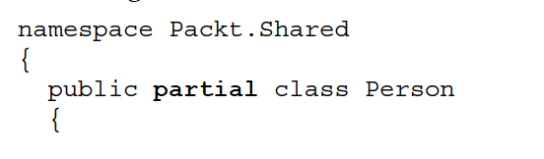
Splitting classes using partial
When working on large projects with multiple team members, it is useful to be able to split the definition of a complex class across multiple files. You do this using the partial keyword.

Slide 22
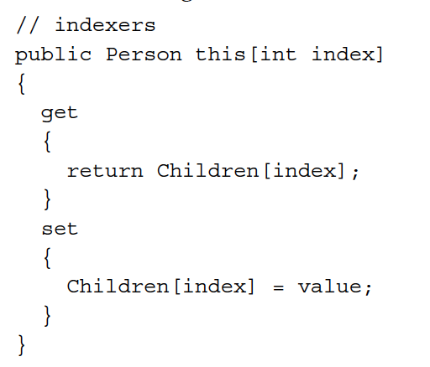
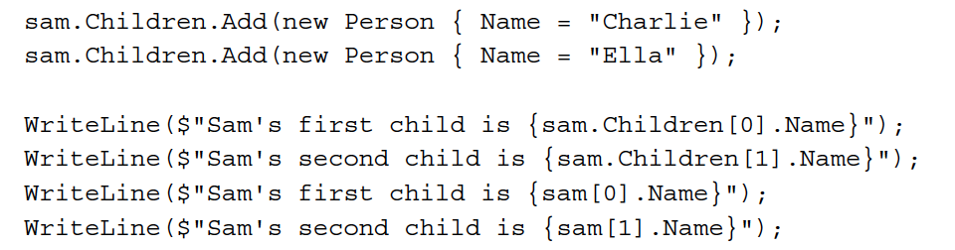
Indexer
Children is a List property in inside Person

Slide 23
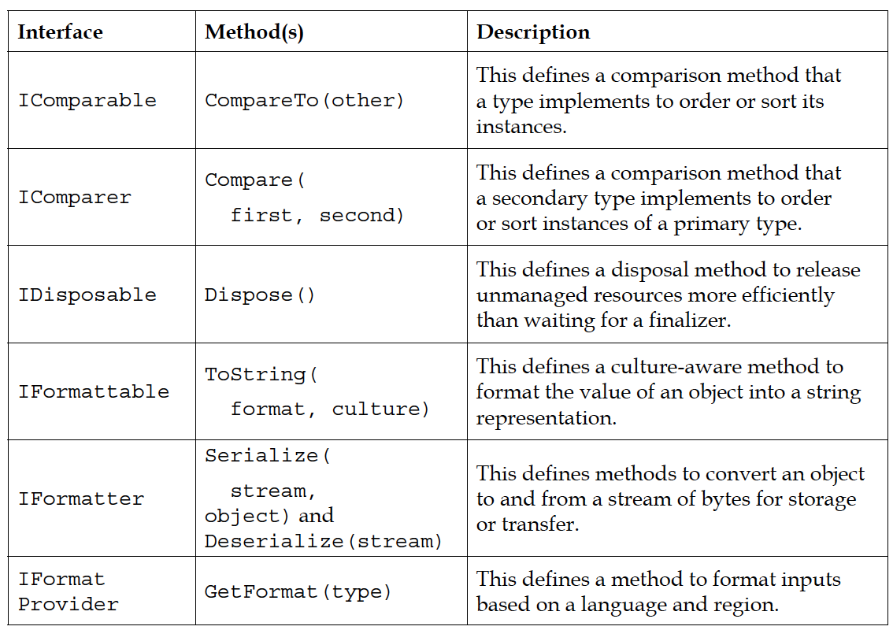
Implementing interfaces
Interfaces are a way of connecting different types together to make new things.
Common interfaces

Slide 24
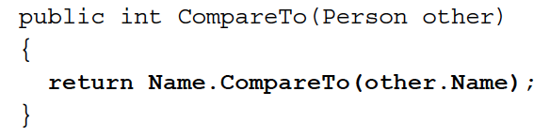
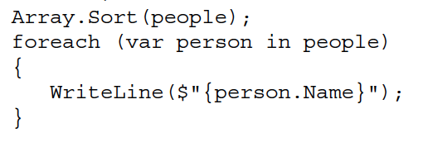
Example of implementing interface

Slide 25
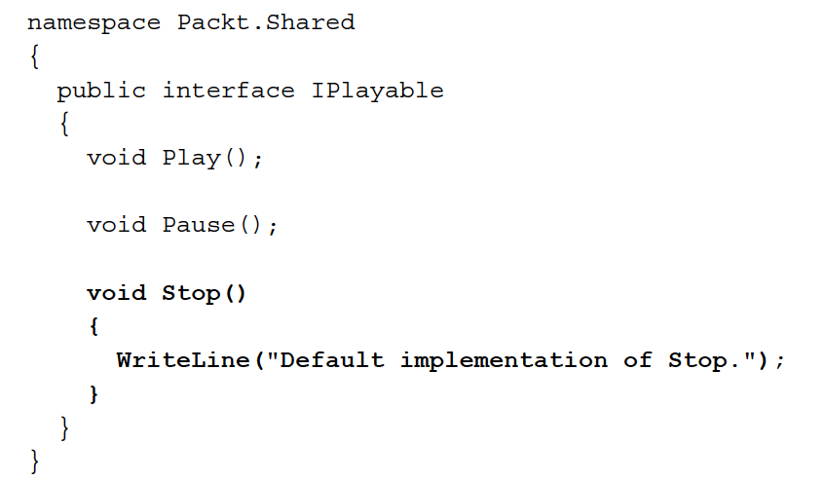
Defining interfaces with default implementations
A language feature introduced in C# 8.0 is default implementations for an interface

Slide 26
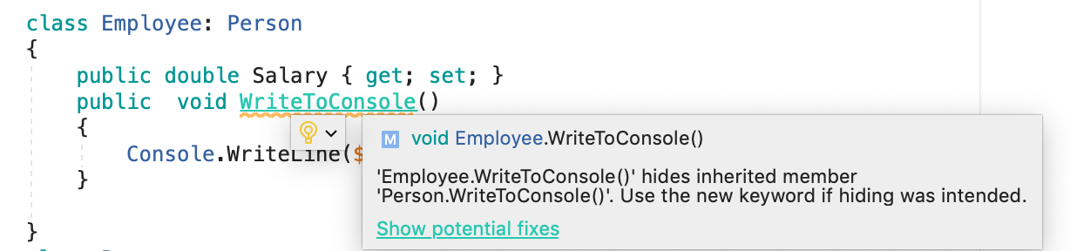
Hiding members

Slide 27
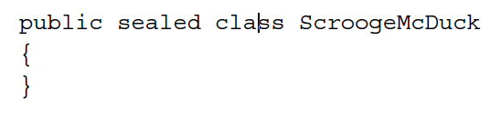
Preventing inheritance and overriding
You can prevent someone from inheriting from your class by applying the sealed keyword to its definition.
An example of sealed in .NET Core is the string class. Microsoft has implemented some extreme optimizations inside the string class that could be negatively affected by your inheritance; so, Microsoft prevents that.

Slide 28
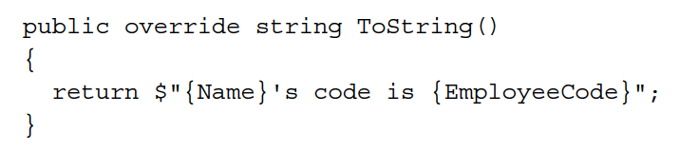
Understanding polymorphism
You have now seen two ways to change the behavior of an inherited method.
We can hide it using the new keyword (known as non-polymorphic inheritance)
We can override it (known as polymorphic inheritance).

Slide 29
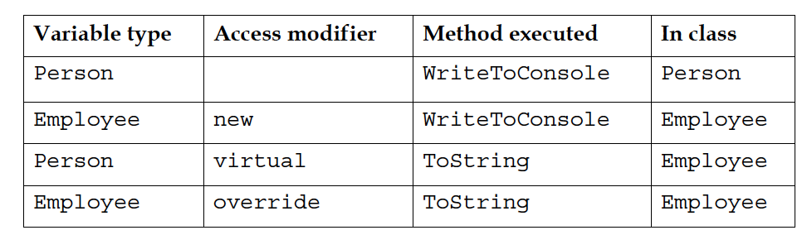
The access modifiers and the effect they have is summarized in the following table

Slide 30
Casting within inheritance hierarchies
Implicit casting
an instance of a derived type can be stored in a variable of its base type
Explicit casting

Slide 31
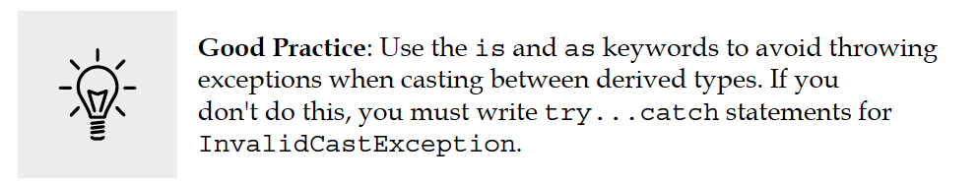

Avoiding casting exceptions
Check if the object aliceInPerson is type of Employee

Slide 32
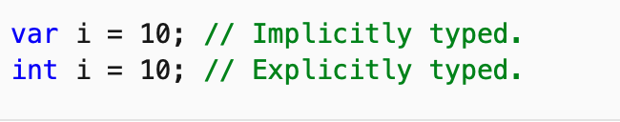
var (C# Reference)
How do you think this is usful?
Beginning in Visual C# 3.0, variables that are declared at method scope can have an implicit "type" var.

Slide 33
Inheriting and extending .NET types
Rather than creating your own completely new types, you can often get a head start by deriving from one of Microsoft's types to inherit some or all of its behavior and then overriding or extending it.

Slide 34
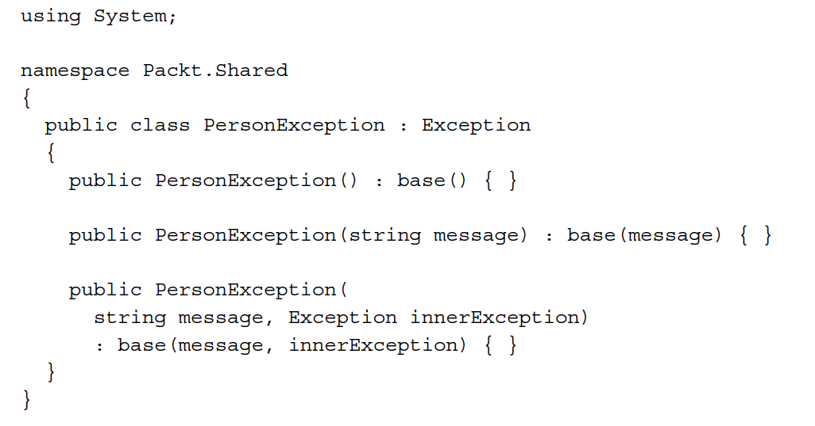
Inheriting exceptions

Slide 35
Using static methods to reuse functionality
Microsoft has applied the sealed keyword to the System.String class so that noone can inherit and potentially break the behavior of strings.
Can we still add new methods to strings? Yes, if we use a language feature named extension methods, which was introduced with C# 3.0.

Slide 36
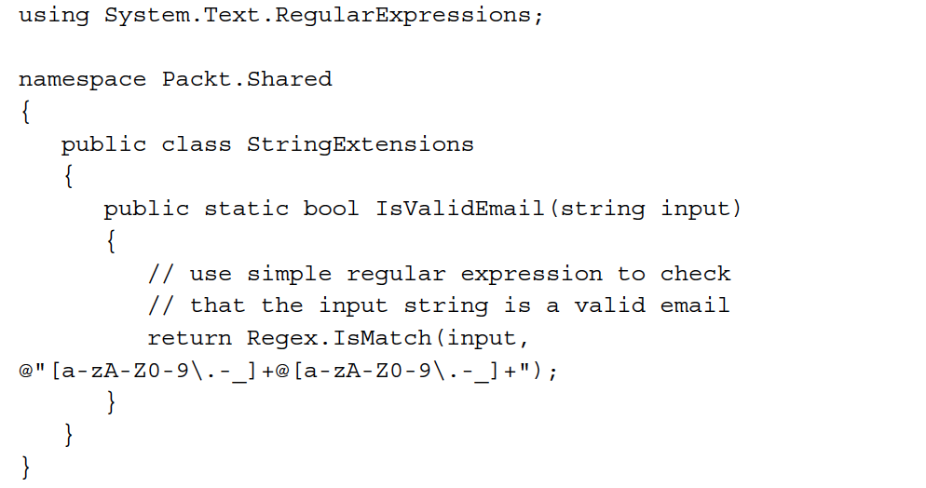
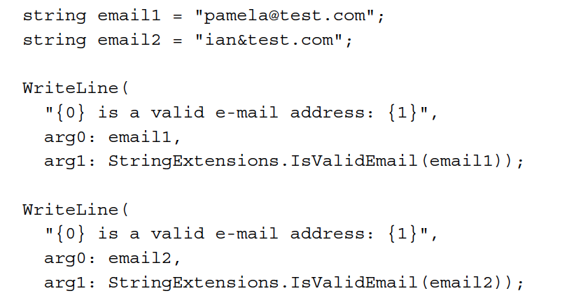
Extension method example

Slide 37
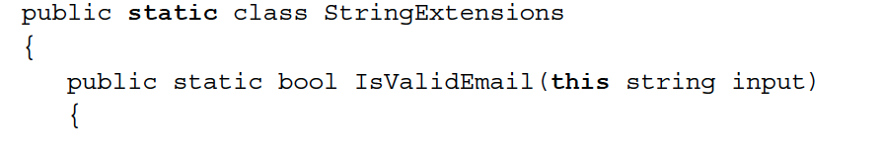
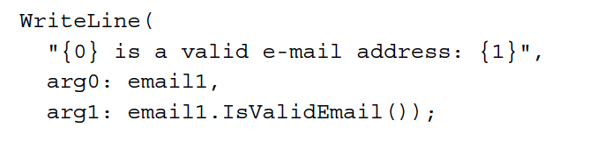
Using extension methods to reuse functionality

Slide 38
References
C# 8.0 and .NET Core 3.0 – Modern Cross-Platform Development Fourth Edition

